Slide 1

Differential Analysis on Performance
of Scientific Collaborations with the Evolution of Entity Popularity
Fang Tan, Tongyang Zhang, Jian Xu
School of Information Management, Sun Yat-Sen University

Slide 2
CONTENTS
1
INTRODUCTION
2
METHODOLOGY
3
PRELIMINARY RESULTS
4
CONCLUSION AND FUTURE WORK
5
REFERENCES
Differential Analysis on Performance of Scientific Collaborations with the Evolution of Entity Popularity
02

Slide 3
INTRODUCTION
Background
Identifying promising research topics is a key success factor of the ultimate success of scientific collaborations [1].
The selection of a promising research topic can encourage the process of scientific discovery scientists and promote the development of the whole research field [2].
Differential Analysis on Performance
of Scientific Collaborations with the Evolution of Entity Popularity
03

Slide 4
INTRODUCTION
Present Study
Focus on the development law that underlie an individual's behavior of selecting topics
Few studies explore the impact of topic popularity
on scientific performance of scientific collaborations from the perspective of entitymetrics.
Differential Analysis on Performance
of Scientific Collaborations with the Evolution of Entity Popularity
04

Slide 5
INTRODUCTION
Purpose
Analyze the evolution of topic popularity in biomedicine related research from the perspective of entitymetrics.
Analyze the effect mechanisms of entity popularity on performance of scientific collaborations.
Provide a theoretical reference for relevant decision makers in research topic selection and the management of scientific research project.
Differential Analysis on Performance
of Scientific Collaborations with the Evolution of Entity Popularity
05

Slide 6
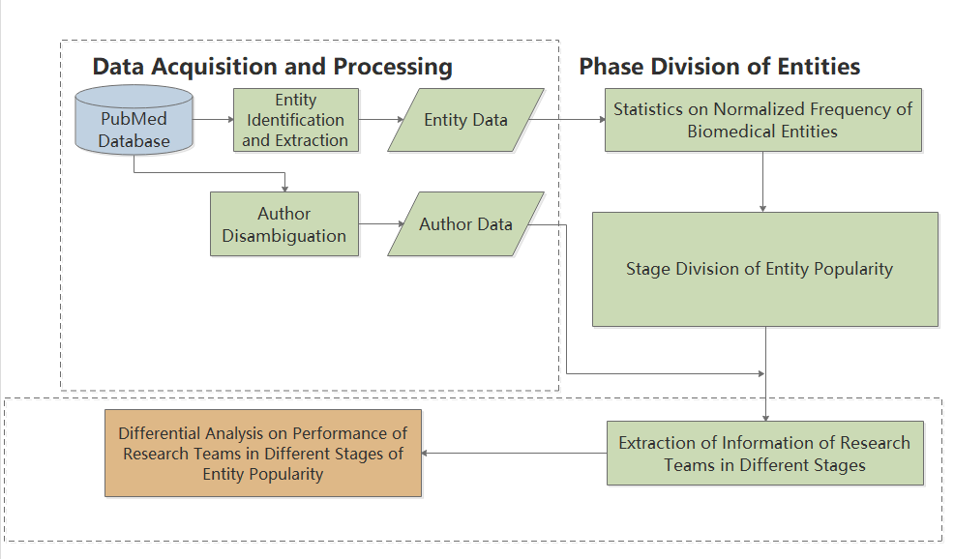
METHODOLOGY
Differential Analysis on Performance
of Scientific Collaborations with the Evolution of Entity Popularity
06

Slide 7

METHODOLOGY
Data acquisition and processing
Biomedical data from PubMed between 1988 and 2017 is obtained based on BERT [3] and Bio BERT [4].
Two types of data:
Entity Data
Author Data
Differential Analysis on Performance
of Scientific Collaborations with the Evolution of Entity Popularity
07

Slide 8
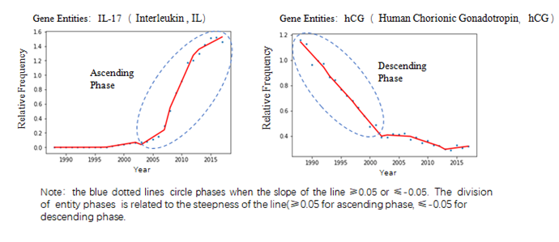
METHODOLOGY
Stage division of entity popularity
Based on the model tree proposed by Ma [5].
The slope k is less than or equal to -0.05 when the entity’s popularity stage is descending (short for “descending stage”); k is greater than or equal to 0.05 when the entity’s popularity stage is ascending (short for “ascending stage”).
Differential Analysis on Performance
of Scientific Collaborations with the Evolution of Entity Popularity
08

Slide 9

METHODOLOGY
Differential analysis on performance of scientific collaborations in various stages of entity popularity.
Compare statistics on the number of published periodical articles and citations of teams of each scientific collaboration in the ascending and descending stages.
We recognize authors of the same article as a research team. Teams in which the number of authors is less than three or over 10, and groups in which ages of authors are all over 45 are ruled out.
As long as the target entities appear in the title of abstract of an article, we consider the team has studied the entities.
Differential Analysis on Performance
of Scientific Collaborations with the Evolution of Entity Popularity
09

Slide 10
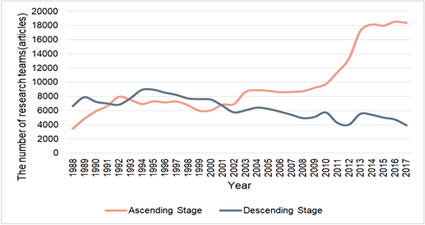
PRELIMINARY RESULTS
Yearly Distribution of the Number of Research Teams in the Ascending Stage and Descending Stage
After the 21st century,
Ascending teams: Has experienced rapid growth.
Descending teams: Shows a slightly declining trend
Differential Analysis on Performance
of Scientific Collaborations with the Evolution of Entity Popularity
13

Slide 11
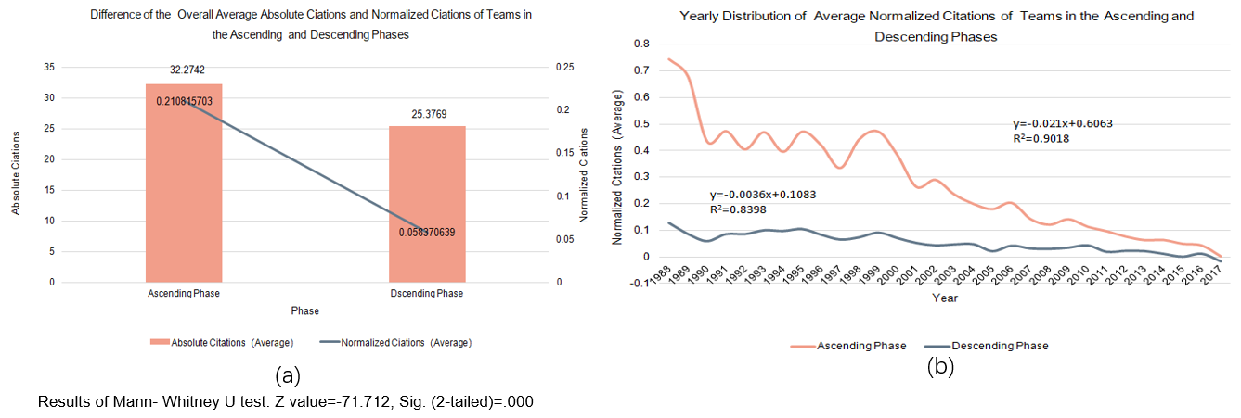
Differential Analysis on Performance of Scientific Collaboration Research
PRELIMINARY RESULTS
Either the overall average normalized citations or the annual average normalized citations of teams in the ascending stage remains significantly higher than that of teams in the descending stage.
For research outputs of teams in the ascending stage, the earlier the published year, the more normalized citations compared to teams in the descending stage.
Differential Analysis on Performance
of Scientific Collaborations with the Evolution of Entity Popularity
14

Slide 12
CONCLUSION AND FUTURE WORK
Conclusion
1
The popularity stage that a research topic is going through can play a role in the research performance of scientific collaboration.
Compared with the descending stage, the ascending stage puts more positive impacts on collaboration research performance
2
For different scientific collaboration modes, the study can be used as a reference in choosing research topics.
3
Differential Analysis on Performance
of Scientific Collaborations with the Evolution of Entity Popularity
19

Slide 13
CONCLUSION AND FUTURE WORK
Future work
1
Differences in other aspects such as personnel composition of a team will be considered in the study.
How sustentation funding, one of the most important external resources to encourage team research, distributes in the two types of teams?
2
3
The impact of other factors (e.g. continuity of government funding) on research popularity.
Differential Analysis on Performance
of Scientific Collaborations with the Evolution of Entity Popularity
20

Slide 14
REFERENCES
[1] Ran Xu, Arash Baghaei Lakeh and et al. 2020. Examining the characteristics of impactful research topics: A case of three decades of HIV-AIDS research. Journal of Informetrics, 15(1): 101122. DOI: https://doi.org/10.1016/j.joi.2020.101122.
[2] Sten Andler. 1979. Predicate path expressions. In Proceedings of the 6th. ACM SIGACT-SIGPLAN Symposium on Principles of Programming Languages (POPL '79). ACM Press, New York, NY, 226-236. DOI: https://doi.org/10.1145/567752.567774.
[3] Ian Editor (Ed.). 2007. The title of book one (1st. ed.). The name of the series one, Vol. 9. University of Chicago Press, Chicago. DOI: https://doi.org/10.1007/3-540-09237-4.
[4] David Kosiur. 2001. Understanding Policy-Based Networking (2nd. ed.). Wiley, New York, NY.
[5] J. Guan, Y. Yan, J. J. Zhang. 2017. The impact of collaboration and knowledge networks on citations. Journal of Informetrics, 11(2): 407-422.
Differential Analysis on Performance
of Scientific Collaborations with the Evolution of Entity Popularity
21

Slide 15
Thank you!
Fang Tan, Tongyang Zhang, Jian Xu
Email:tzhang39@163.com
School of Information Management, Sun Yat-Sen University

